Slide 1
Upscaling Basic Sanitation for the Urban Poor (UBSUP)
DTF Site Selection Site Surveying

Slide 2
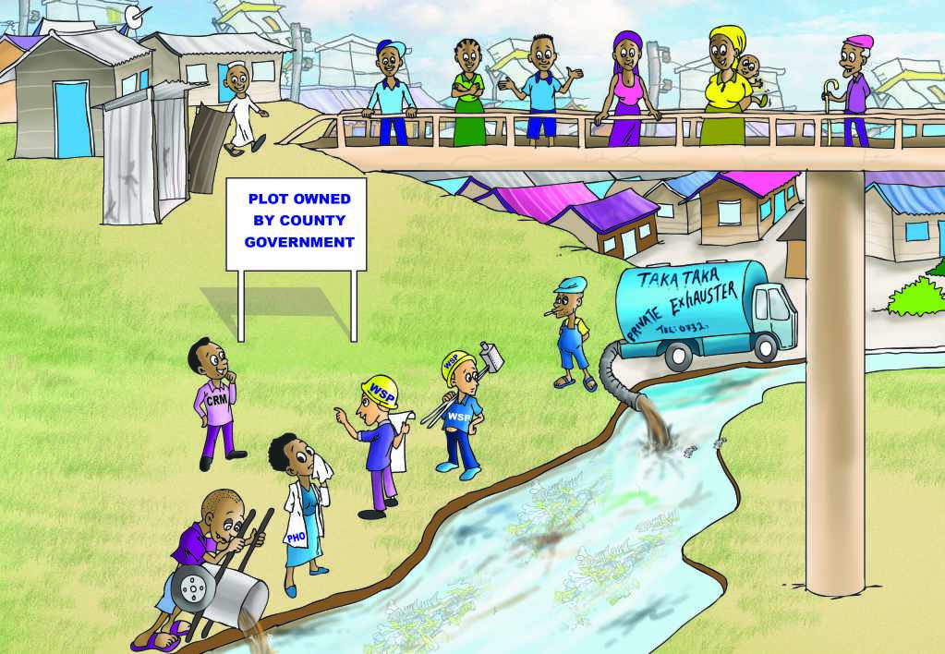
Objective: You are able to collect data required to prepare the final design

Slide 3
Content
Questions you might to ask yourself:
What is the context of this session?
How is this tool used?
May I try it with my colleagues?

Slide 4
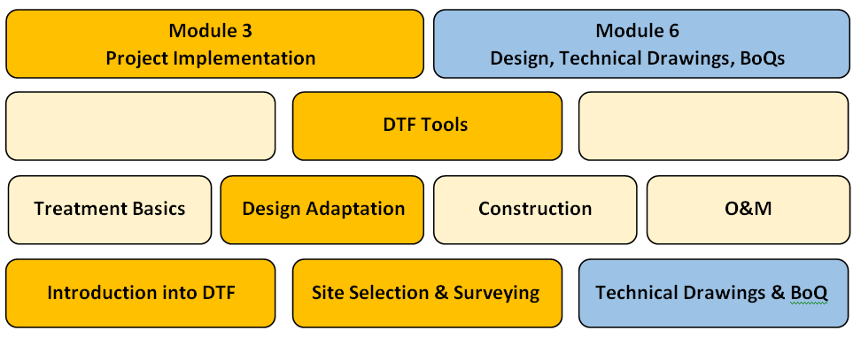
What is the context of this session?
The UBSUP SafiSan Toolkit
all info can be found in your manual

Slide 5
How is this tool used?
The tool consists of 3 parts:
A template layout plan to capture required information
Templates of tables to note required data
A step-by-step instruction which data to be collected, and how

Slide 6
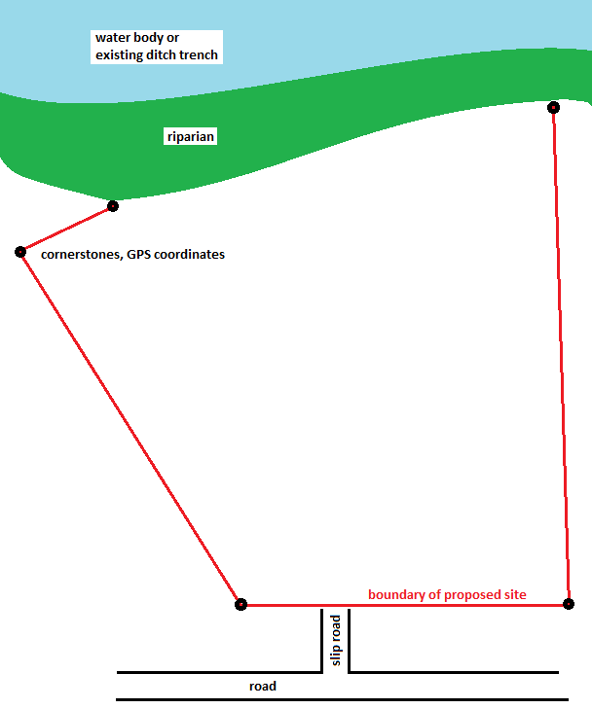
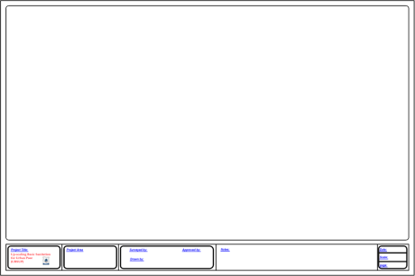
Step 1 – Boundaries of DTF site
Mark corners (e.g. with metal rods)
Take preferably GPS coordinates of cornerstones
Note distances on the layout drawing
Ensure sufficient distance (riparian) to water bodies as per NEMA

Slide 7
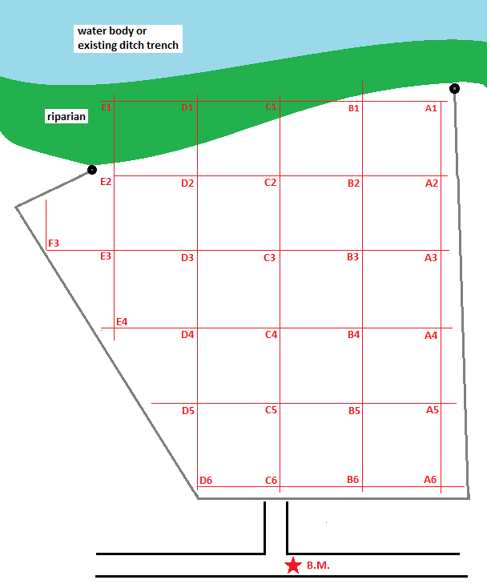
Step 2 – Raster levelling
Define a fix and suitable benchmark (should also be used during construction, visible from the entire site to avoid transfers)
Mark location of BM on layout drawing and permanently at site
Take levels according to a fix raster with 20-30 points
Note levels with a clear reference to the location at provided template
Reference Point | Level (m)
B.M. | 0.000
A1
A2
A3
...
...
„Levelling“ is explained in the next session

Slide 8
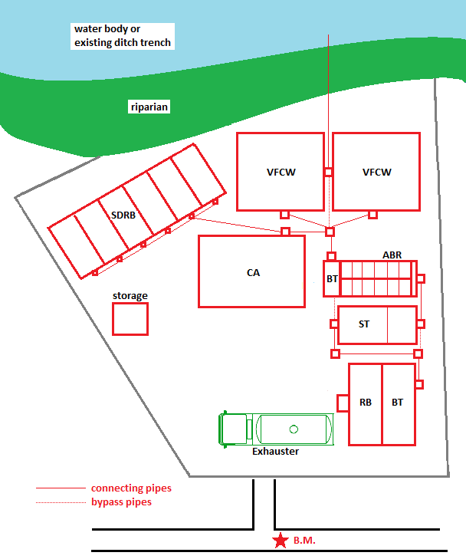
Step 3 – Arrangement of modules
Draw modules: e.g. treatment of FS and UDDT matter on a new layout plan
Consider space for manoeuvring of exhauster trucks
Ensure proper arrangement of pipes and inspection boxes
Don´t forget proper arrangement of bypass pipes

Slide 9
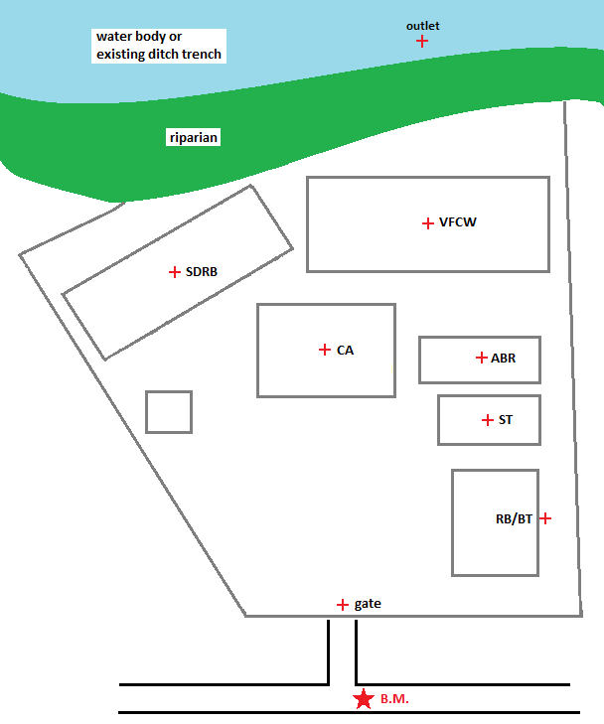
Step 4 – Levelling at particular locations
Take levels at the following locations
Level of the final effluent discharge point (flooding level)
Ground levels where different treatment modules will be located
Existing ground level where the RB will be located
Existing ground level at gate
Note levels in table template with clear reference
Reference Point | Level (m)
B.M. | 0.000
Outlet
VFCW
CA
ABR
...
Required to check whether pumping required

Slide 10
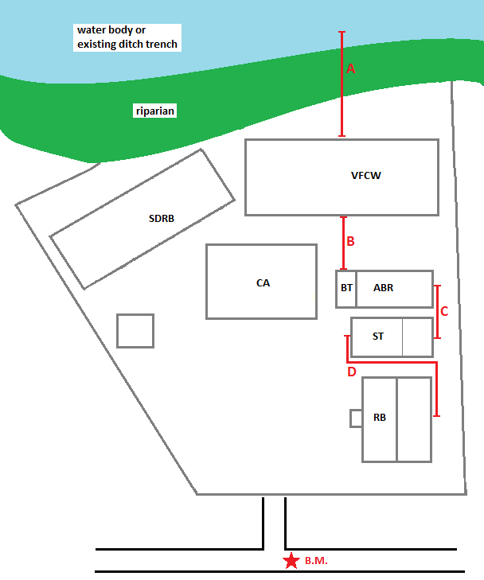
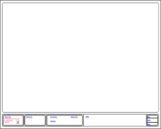
Step 5 – Measurement of distances
Take distances between the treatment modules that are arranged in series:
VFCW outlet to final discharge point
Outlet of ABR-BT to VFCW
ST outlet to ABR inlet
Outlet of RB/BT to ST inlet
Note distances on layout plan and in table
Reference | Distance (m)
A
B
C
D
Pipe slopes will lead to required levels of modules

Slide 11
Step 6 – Determination of soil conditions
Establish soil conditions at all locations where excavation is required
Particularly for ST and ABR (underground)
But also all modules (foundation)
Note levels in table template with clear reference
Reference Point | Soil conditions
RB/BT
ST
ABR
VFCW
SDRB
CA
House
Soil conditions determine excavation cost in BoQ

Slide 12
May I try it with my colleagues?
We will have a field trip to a potential site where you can apply the tool
For this purpose you will get 5 empty title blocks and several table templates to be filled
Prior to that, you will learn how a levelling machine is used
Field Trip & Group Exercise “Site Surveying”:
Please arrange required modules (RB/BT, ST, ABR, VFCW, SDRB, CA) on a title block within your DTF technical teams
Discuss with other participants and trainers the layout
Measure required dimensions and levels and fill into provided tables

Slide 13
Do you have any questions, remarks or suggestions?

